Slide 1
EudraCt – Results Webinar # 1
Presented by Tim Buxton on 20 January 2016
IT Service Strategy Manager, IT Operations

Slide 2
Instructions for sponsors Frequently asked questions

Slide 3
Timeline
21 December 2016 | Deadline for submission of summary results for trials categorised as to be posted ≤ 24 months after finalisation of the programming (see document “Trial results: modalities and timing of posting” published on the EudraCT website)
13 January 2016 | Date from which EudraCT - Results system is available Posting and publication process operational
13 March 2016 | Results sets falling due after this date (except those for trials categorised as to be posted ≤ 24 months after finalisation of the programming) should comply with the modalities and timing of trial results
13 July 2016 | Date by which results sets affected by the system closure are to have been posted.
Q1
Q2
Q3
Q4

Slide 4
Activities necessary to return to normal operation
Review by sponsors of trial results sets within the system leading to:
Correction where needed by the sponsor
Authorisation to EMA to restore results sets to public view where no correction is needed
Submission of data
Affected results sets
Results for trials categorised as to be posted ≤ 24 months after finalisation of the programming

Slide 5
Affected results sets
Results sets that were posted, published and removed from public view as of 31 July 2015
Results sets that had been posted but not yet published as of 31 July 2015
Results sets that fell due in the period that the system was closed (31 July 2015 to 12 January 2016)
Results sets that fall due in the two months following re-opening of the system (13 January 2016 to 13 March 2016)

Slide 6
Resources: Schedule of trials assigned to a primary user

Slide 7
Resources: Release notes for version 10.2.1.0
Summary of release 10.2.1.0
Major items fixed in release 10.2.1.0
Known issue in release 10.2.1.0
Full release contents – Issues fixed
Known errors
New Validation Violation Messages (for XML upload) in EudraCT - Results 10.2.1.0
Additional information
Installation steps deviating from the deployment guide

Slide 8
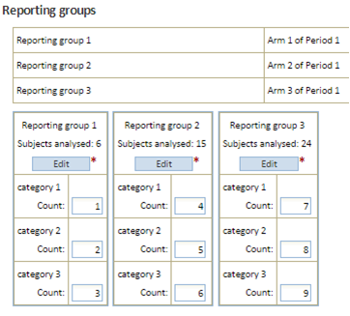
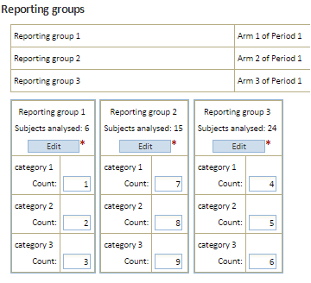
Trials potentially affected by timestamp issues

Slide 9
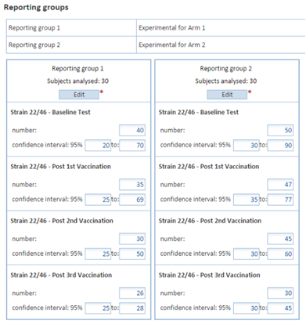
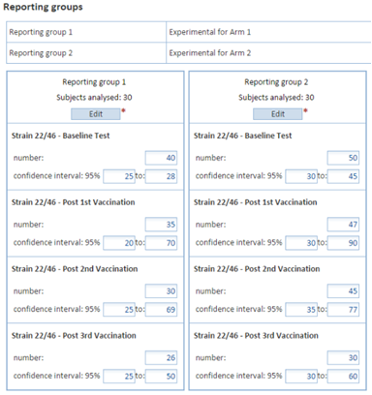
Trials potentially affected by category issues

Slide 10
Trials where an automated process has been run to eliminate duplicated non-completion or joining reasons

Slide 11
Restore status and return to public view process
Notifications
Sponsor notification to EMA: Finalized results set in the system is correct
EMA notification to sponsor: Status of finalized results set is restored
Published messages:
Messages removed:
“Removed from public view”
“These results have been removed from public view whilst they are reviewed and may need to be corrected before being returned to public view”

Slide 12
Tagging of superseded versions of results sets that included affected data
Notifications
Sponsor notification to EMA: New version of finalized results set containing corrected data
EMA notification to sponsor: Superseded versions tagged
Published messages
Messages removed:
“Removed from public view”
“These results have been removed from public view whilst they are reviewed and may need to be corrected before being returned to public view”
New message:
“Due to a system error, the data reported in this version is not correct and has been removed from public view”

Slide 13
Tagging of results sets submitted in compliance with revised timelines
Notifications
Sponsor notification to EMA: Results set submitted in compliance with revised timelines
EMA notification to sponsor: Results set submitted in compliance with revised timelines tagged
Published message
New message:
“Due to the EudraCT – Results system being out of service between 31 July 2015 and 12 January 2016, these results have been published in compliance with revised timelines”

Slide 14
Instructions for sponsors Frequently asked questions

Slide 15
EudraCt Training – Training environment
System and data availability
[EMA] does not guarantee the availability of the training application.
The system may be refreshed from time to time and this may cause the loss of data saved into the application as well as loss of user log in credentials.
Any trials data prepared in the EudraCT training environment are for training purposes only.
Status
Most credentials still valid
Previously available data no longer available
Self-registration and trial assignment available

Slide 16
Draft trials - message
All trials in the system as of 31 July 2015 which had been assigned for results tagged with the message:
“These results have been removed from public view whilst they are reviewed and may need to be corrected before being returned to public view”
Not appropriate for trial results that had not been posted as of 31 July 2015
Removed from all draft trial results to which attached as of 31 July 2015

Slide 17
Primary user
EMA assigns each clinical trial to a primary user for result related information
On request of an individual acting on behalf of the sponsor, the addressee of the decision on a paediatric investigation plan or the marketing authorisation holder
This assignment enables the user to assign one backup user and multiple delegated results preparers and posters for each listed trial
The primary user is expected to manage
the backup user and delegated preparers, and
the transition between primary users on change of personnel or assignment at the sponsor

Slide 18
Issue resolution
The release notes list the issues resolved in release 10.2.1.0
A number of service desk tickets remain open. These will be closed gradually as part of the return to normal operation

Slide 19
Outcome of the automated duplicate reason fix
Is it possible to download XML from a finalised Results set?
Yes. XML of the current version, including finalized results, can be downloaded at any time
Are records affected by the automated duplicate reason fix tagged?
No. A detailed listing has been supplied to all primary users whose trial results sets have been subject to the automated duplicate reasons fix
Is there a norm for this category?
All trial results sets in which the duplicate reason was identified have been corrected, and the status (whether draft or finalized) left unchanged

Slide 20
Communications
For the formal notifications outlined in the Instructions for sponsors; and
The acknowledgement of the email with the Instructions for sponsors;
Use: EudraCT-R@ema.europa.eu
For all other queries related to EudraCT – Results and this exercise, please use:
eudract@ema.europa.eu

